Slide 1

Basic yocto investigation
Yocto project
May 09, 2017
Gstreamer project, Multimedia fw team,
R-Car Software Solution 2 group
Renesas design vietnam co., ltd.
Renesas Electronics Corporation

Slide 2
Basic yocto investigation
Yocto project
Name: huynh quoc hoang
Mentor: ha thuc anh

Slide 3

Agenda
Introduction to Embedded Linux build systems Page 19
Yocto Project and Poky reference system overview Page 30
THE YOCTO PROJECT OVERVIEW PAGE 31
THE POKY REFERENCE SYSTEM OVERVIEW PAGE 38
Using Yocto Project - basic Page 44
Environment setup page 45
Configuring the build system page 53
Building an image page 56
APPLYING PATCHES PAGE 107

Slide 4
Agenda
IMAGE Page 214
INTRODUCTION TO IMAGES PAGE 214
IMAGE TYPES PAGE 221
PAKAGE GROUPS PAGE 225
LICENSING Page 253
MANAGING LICENSES PAGE 254
TARGET CONFIGURATION Page 12

Slide 5
Build System benefits
BUILD SYSTEM | Automatic: Automate the process of building a target system, including the kernel, toolchain. Automatically download, configure, compile and install components in the right order, fix cross-compiling issues.
 | Integrated software: Make sure all the application dependencies are matched
 | Adaptability: Contain a large number of packages, that should fit your requirement, easily extensible.
 | Reproducible: Easy to change the configure of some components, upgrade, fix, bug,…
 | Process: Some configurations can be handled in the same project, it is possible to generate the same root file system for different hardware target.

Slide 6
Build System benefits
Development application
External repository
Download
source
Build system
Build
The build system is used to build the full system and to provide a working image to the customer

Slide 7
The yocto project and poky reference system overview
Set of template,tools, methods: allowto build custom embedded Linux-based system
Yocto project
Open source project initiated by the Linux foundation in 2010

Slide 8
The yocto project and poky reference system overview
The core components of the Yocto project:
BitBake, the build engine: task schedule, like make. It interprets configuration files and recipes to perform a set of tasks, download, configure and build specified package and filesystem image.
Openembedded-Core: a set of base layer: set a recipes, layers and classes which are shared between all OpenEmbedded based systems.
Poky, the reference system: collection of projects and tools, used to bootstrap a new distribution based on the Yocto Project.

Slide 9
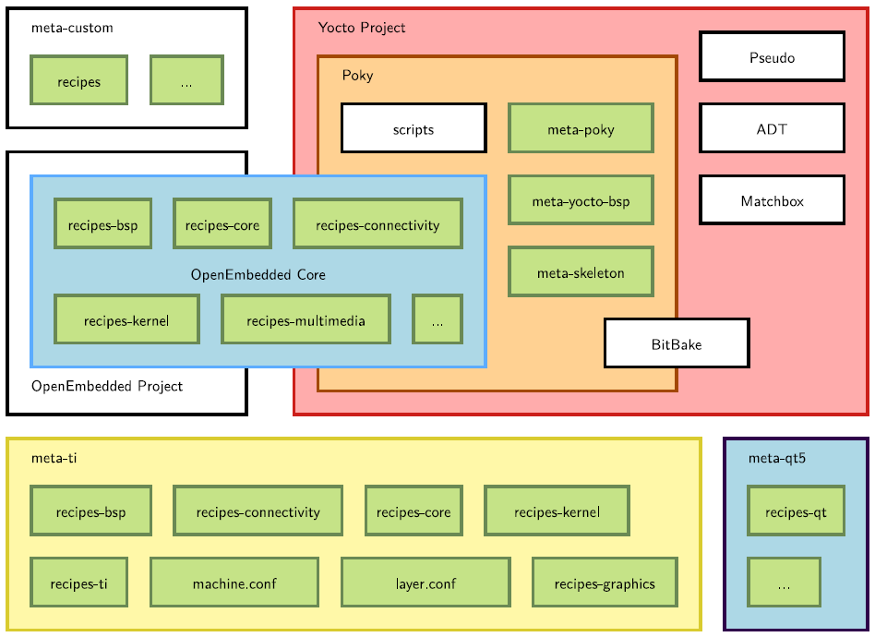
The yocto project and poky reference system overview yocto project lexicon

Slide 10
The yocto project and poky reference system overview yocto project lexicon
Layer: set of recipes, matching a common purpose
Recipes describe how to fetch, configure, compile an package application and image
OpenEmbedded-Core
Multiple layers are used within a same distribution
Support QEMU emulated machines
Support the ARM, MIPS(32 and 64 bits), PowerPCx86(32 and 64 bits) architectures

Slide 11
The yocto project and poky reference system overview yocto project lexicon
The Yocto Project provides a common base of tools and layers on top of which custom and specific layers are added, depending on our target.
The main required element is Poky, the reference system which includes OpenEmbedded-Core. Other available tools are optional, but may be useful in some cases.

Slide 12
The yocto project and poky reference system overview the poky reference system overview
Download the Poky reference system: git clone -b krogoth git://git.yoctoproject.org/poky.git
bitbake/ : Holds all scripts used by the BitBake command. Matches the stable release of the BitBake project
documentation/ All documentation sources for the Yocto Project documentation. Can be used to generate nice PDFs
meta/ Contains the OpenEmbedded-Core metadata.
meta-skeleton/ Contains template recipes for BSP and kernel development.
meta-poky/ Holds the configuration for the Poky reference distribution.
meta-yocto-bsp/ Configuration for the Yocto Project reference hardware board support package

Slide 13
The yocto project and poky reference system overview the poky reference system overview
LICENSE The license under which Poky is distributed (a mix of GPLv2 and MIT).
oe-init-build-env Script to set up the OpenEmbedded build environment. It create the build directory, takes an optional parameter which is the build directory name.
Scripts: contain scripts used to set up the environment, development tools, and tools to flash the generated images on the target.

Slide 14
www.renesas.com

